Slide 1
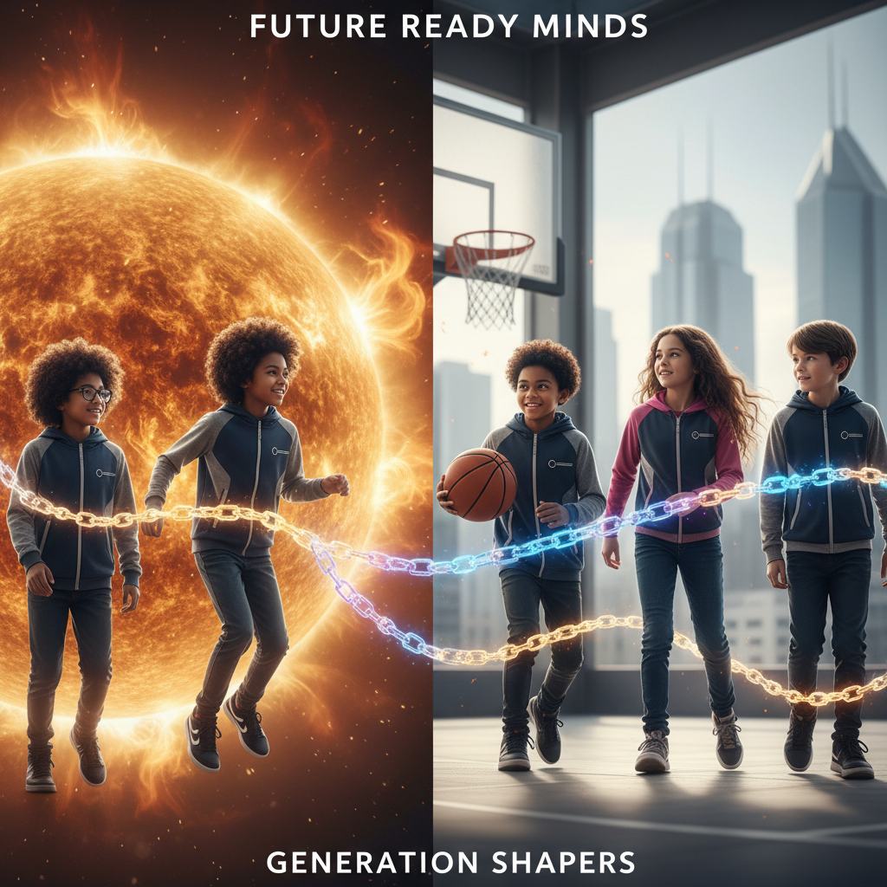
ModelIt!
Student Lesson
Powered by the Sun
How Pizza, Basketball, and Your Heartbeat Are All Solar Energy
NGSS: 5-PS3-1
5th Grade
1/9

Slide 2
What You Will Learn Today
Learning Goals
* Trace the energy chain from the sun through plants to animals
* Model how sunlight intensity affects photosynthesis rate
* Explain how temperature influences plant energy production
* Predict what happens to animals when sunlight availability drops
Key Vocabulary
Photosynthesis
The process plants use to convert sunlight into sugar
Producer
An organism that makes its own food using sunlight
Consumer
An organism that eats other organisms for energy
Energy Transfer
The movement of energy from one organism to another
2/9

Slide 3
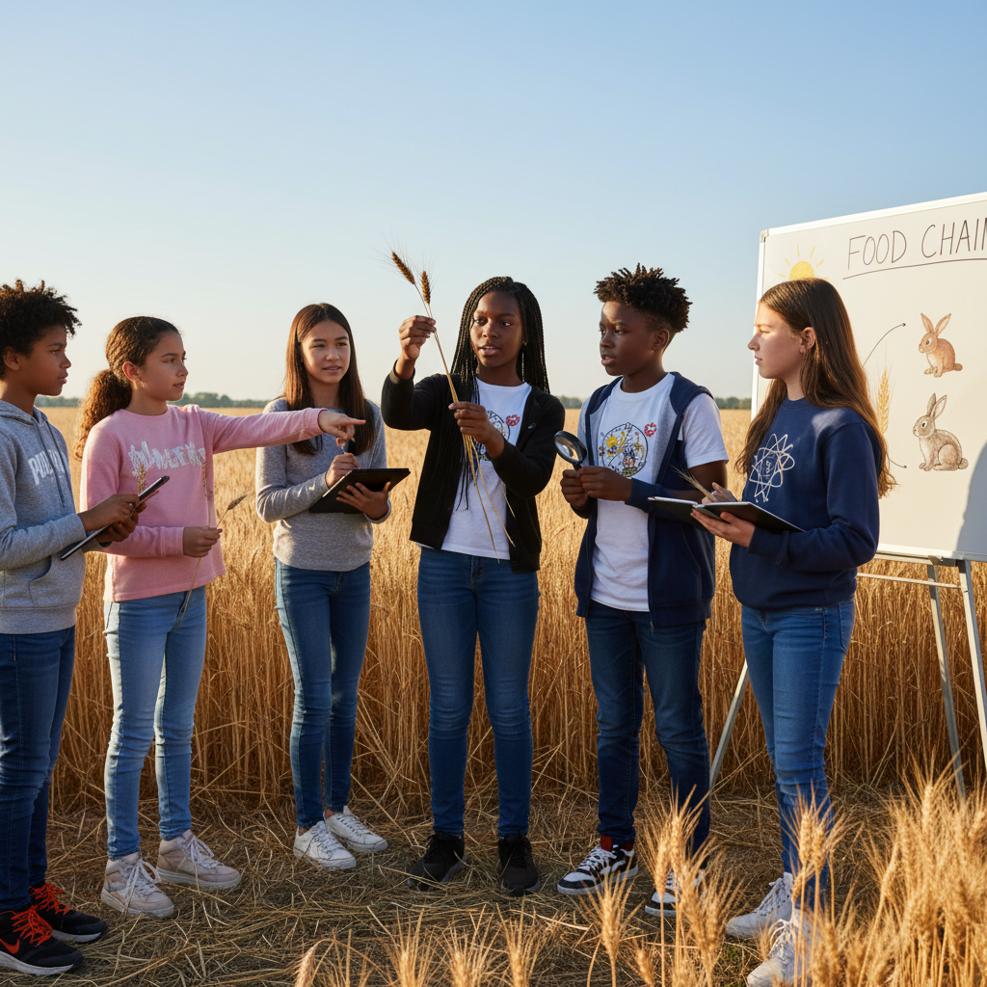
The Big Question
How does energy from the sun become the energy in your body?
How Pizza, Basketball, and Your Heartbeat Are All Solar Energy. Today we'll build a MODEL to discover the answer!
3/9

Slide 4

Today We Will Build a Model!
A model helps us understand complex systems!
1. LOCATE
Identify the COMPONENTS (parts) of the system
2. ESTABLISH
Connect them with RELATIONSHIPS (+ or -)
3. VISUALIZE
Build your model in ModelIt!
4. EVALUATE
Run SIMULATIONS to test scenarios
5. REVISE
Improve your model based on evidence
4/9

Slide 5

Activity 1: Sort the Components
Sort these components into EXTERNAL (inputs from outside) and INTERNAL (inside the system):
Your Components:
* Sunlight Intensity
* Temperature
* Photosynthesis Rate
* Energy Available to Animals
Think: Which components can we control? Which happen on their own?
5/9

Slide 6
Activity 2: Connect with Arrows
Draw arrows to show HOW components affect each other:
(+) POSITIVE Relationship
When one goes UP, the other goes UP too
(-) NEGATIVE Relationship
When one goes UP, the other goes DOWN
Think About It:
When sunlight increases, what happens to the amount of energy available in the ecosystem?
6/9

Slide 7
Activity 3: Run the Simulation!
Test these scenarios in ModelIt!
Summer Conditions
Set Sunlight and Temperature to high levels
Winter Conditions
Lock Sunlight to 25% and Temperature to 25%
Total Eclipse
Lock Sunlight to 0% and observe the cascade
Watch the activity graphs change!
[ModelIt Platform Screenshot - Simulation Results Graph]
7/9

Slide 8
What Did We Discover?
Our Model Showed Us:
* All energy in food originally came from sunlight
* Photosynthesis converts solar energy into chemical energy (sugar)
* When sunlight drops, the entire food chain is affected
* Animals hibernate and migrate because winter reduces available energy
Answer: The sun's energy is captured by plants through photosynthesis, stored as sugar, and transferred to animals when they eat plants!
8/9

Slide 9
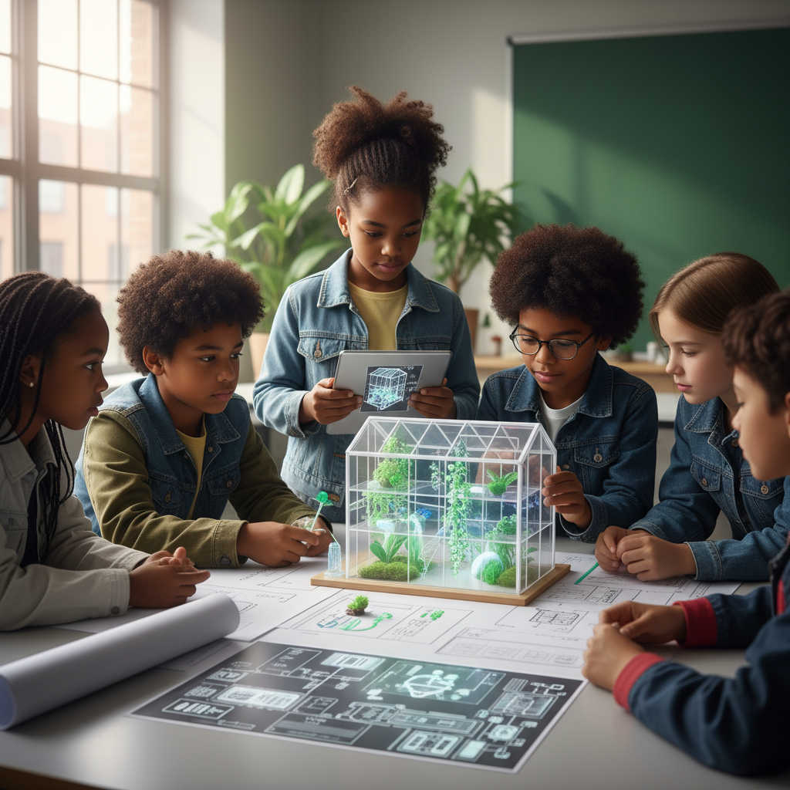
STEM Challenge: Design a Greenhouse for Mars
YOUR ENGINEERING MISSION
Design a greenhouse that could grow food for astronauts on Mars, where sunlight is weaker.
The Challenge:
NASA is planning a Mars colony. They need you to design a greenhouse that maximizes photosynthesis with limited sunlight.
Think Like an Engineer:
* How much weaker is sunlight on Mars compared to Earth?
* What conditions do plants need for maximum photosynthesis?
* How could you supplement natural sunlight?
REAL CAREER CONNECTION: Sports Nutritionists and Exercise Physiologists optimize how athletes convert food energy into performance. They earn $55,000-$90,000/year. The skills you're using TODAY are the same ones they use on the job!
9/9

